Slide 1
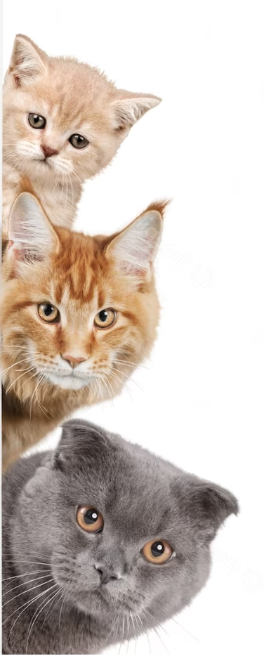
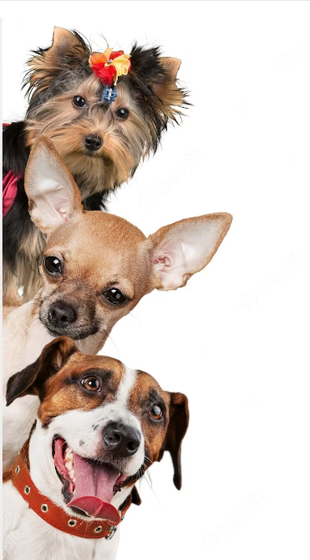
PET WARS
CATS vs DOGS

Slide 2
What is Pet Wars???
TBSG - Turn Based Strategy Game
Created using PyGame
You got limited moves each turn(day)
Main game is focused on hiring an army and exploring the adventure map
You can fight neutral armies and collect resources
The main goal is to defeat the prime evil - Shaq the Pug

Slide 3
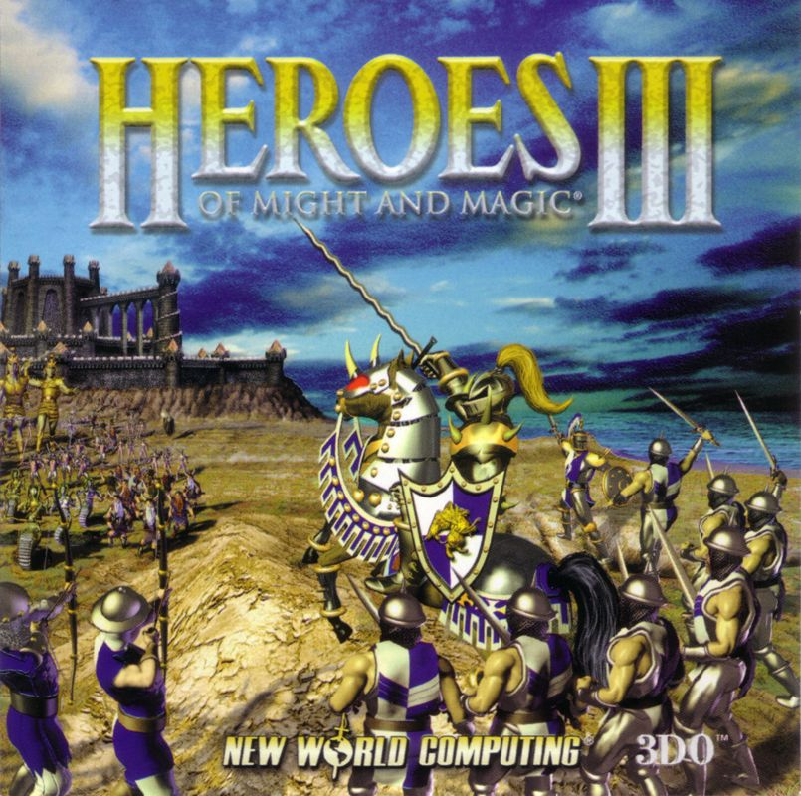
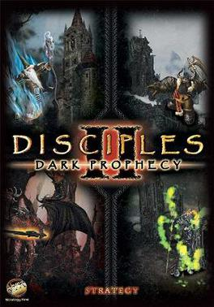
INSPIRATIONS

Slide 4

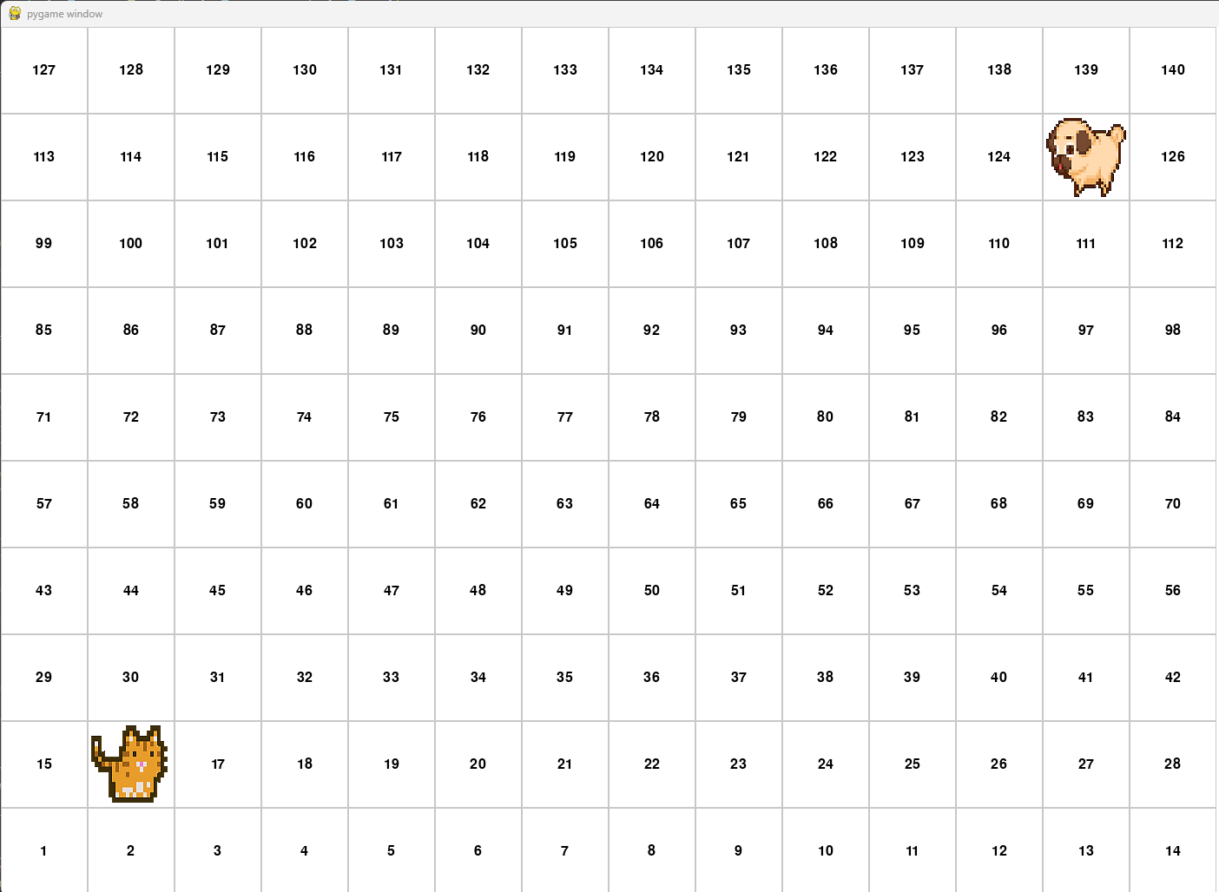
How it Started?

Slide 5
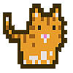
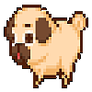



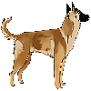
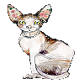
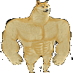
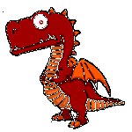

CATS
Fractions!
DOGS
Nebuchadnezzar: Our hero!
The cats follow him, but he never
takes part in a fight!
Shaq: The prime evil, the leader of all dogs. Controlled by AI. Defeat him and you win the game!
Street Cat: Found on the street.
Basic melee unit. Don’t expect much!
PUG: Slow speed, weak melee attack. Deteriorating vision. I suspect he is relative to Shaq.
The Persian: Loves milk!
The cats archer, however
I still can’t explain how it shoots.
Malinois: The dogs ranged unit. Artificially created. Attacks for no reason.
The Sphynx: Guardian of the pyramids. A top tier melee unit.
Attacks twice.
Shiba Innu: The top tier dog unit. Can teleport on the first turn on the battlefield. Sent by Elon Musk on expedition to the moon.
What is a computer game without a dragon? Don’t poke him! Kills every stack on the battlefield with one strike only!
Neutral:
It’s a mouse. Annoying, usually guards something that no one wants. 1 Attack, 1 Defense, 1 Health.

Slide 6





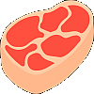
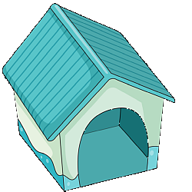
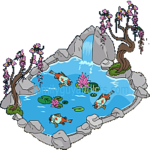
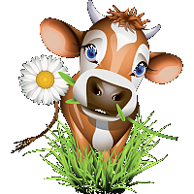
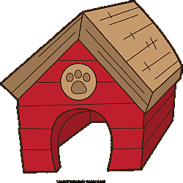

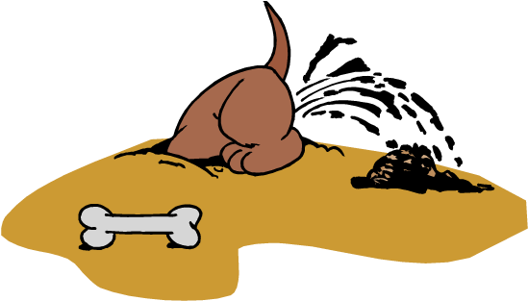
CATS
Resources
DOGS
Meow Coin is what the cats
are using instead of gold. It is so bad
that I use Monero image instead.
Doge Coin helped a lot of people to retire. However it’s not always used with good intentions.
Milk. 3.6% of Fat.
Produced by a happy cow.
The bones are usually found in the garden. Unknown origin.
Fish is caught by the cats during
their spare time. Get control
of the fish pound to get it daily.
Meat is getting production bonus
In every Bulgarian village the weeks before Christmas.
Production
Cat House: collects 1000 Meow Coins daily from cats taxes
Milk Farm: produces
2 milk daily
Fish Pound: produces
1 fish daily
Dog House: collects 1000 Doge Coins daily from dogs taxes
Bone Yard: produces
2 bones daily
Pig Farm: produces
1 meat daily

Slide 7
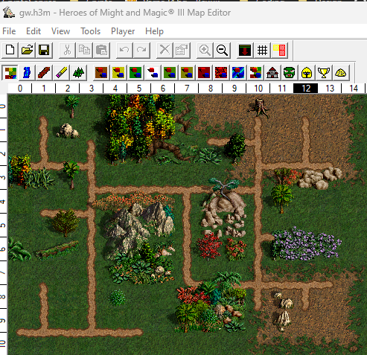


Few words about the artwork and the map creation!
All assets are transparent png images randomly found on google. I tried using AI for generating the artwork or ready tilesets, but the result was unsatisfactory.
For the map, my first option was Tiled. There are a lot of specifics which were stopping me to use pre-ready tile sets. Due to the limited time and the complicity of Tiled I dumped the idea. However, it still could be a good base for future issues!
My second choice
was game maker. I have used it many years ago but wasn’t expecting it to evolve so much.
Finally considering the limited time for developing I decided to move to the next option.
HoMM 3 map editor
had everything I needed and was super easy to use. Even if it not meant for this purpose, the result was great. However, this needs to be changed to one of the previous 2 options if I want to further develop the project

Slide 8
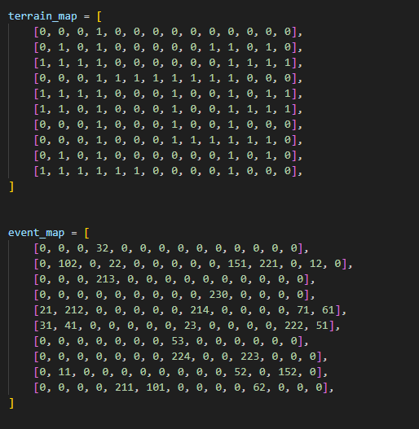
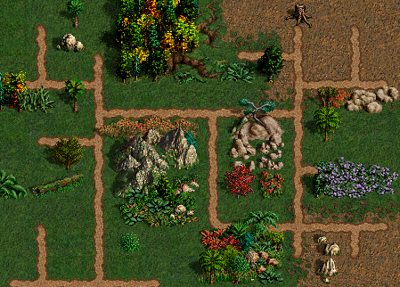
What is behind the map:

Slide 9
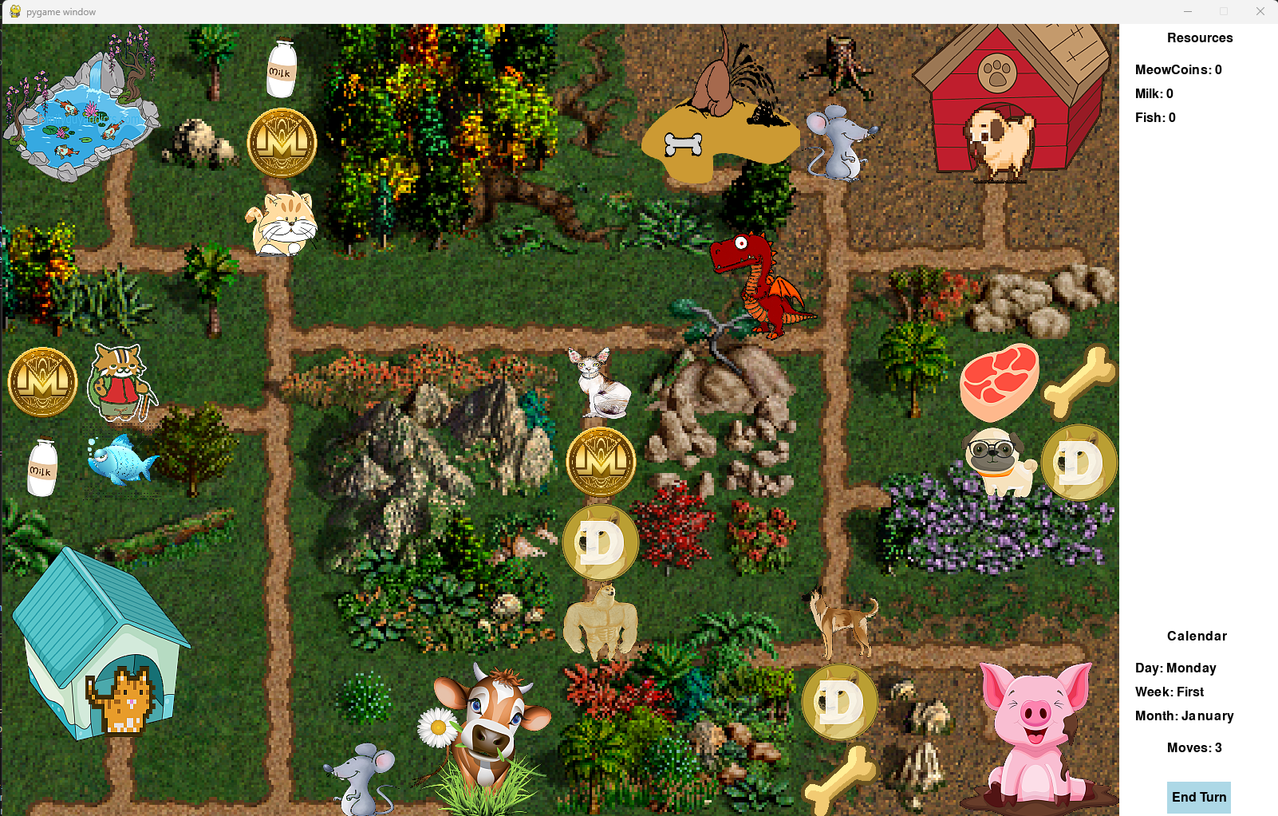
Current Version (adventure map)
Controls:
Keyboard arrows
are moving the hero
to the next neighboring
Tile. Pressing E activates end of turn.
Alternatively you can
control the hero by mouse – by clicking on the neighboring tiles or the End Turn button on the bottom right corner.

Slide 10
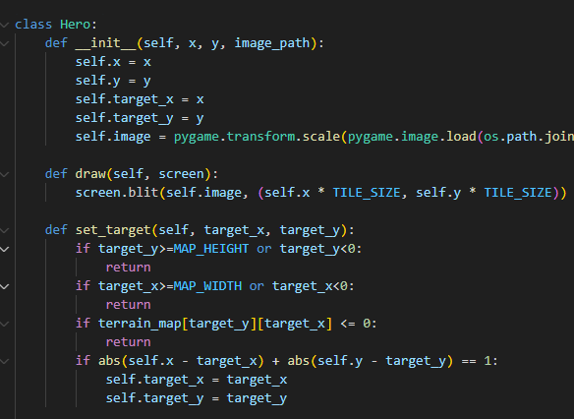
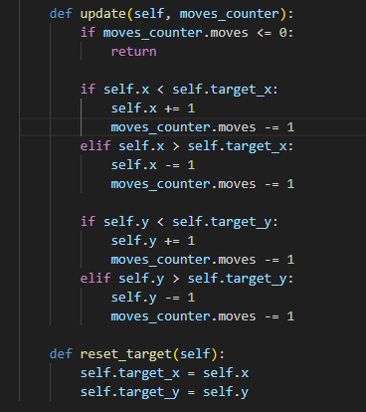
Code Talk – HERO class

Slide 11
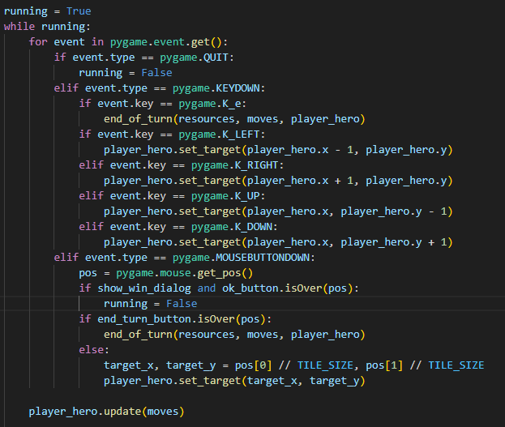
Hero Movement Logic

Slide 12
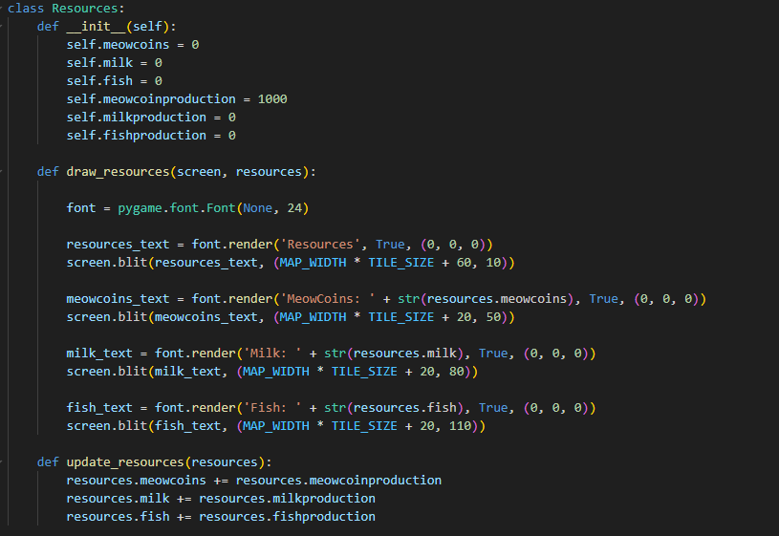
Drawing the resources to the interface

Slide 13
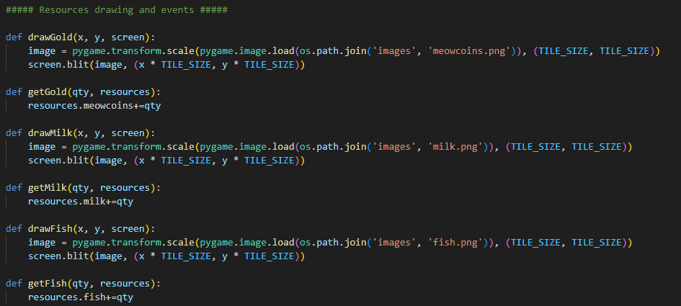
There were transformed from classes to just 2 functions, so now they are fully dependent on the map:

Slide 14
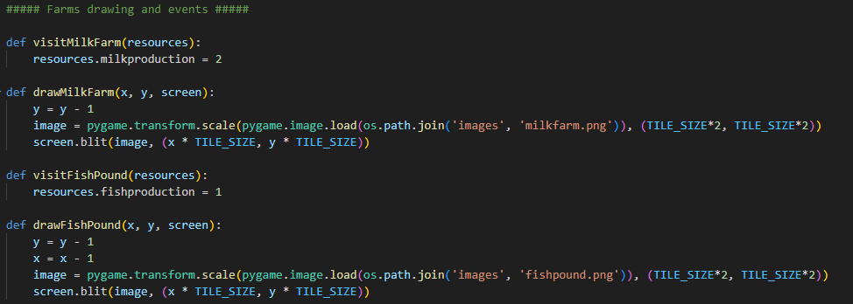
Same approach was used for the farms:

Slide 15
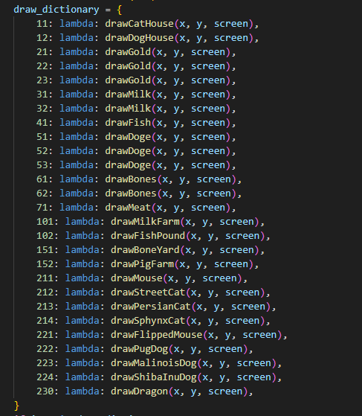
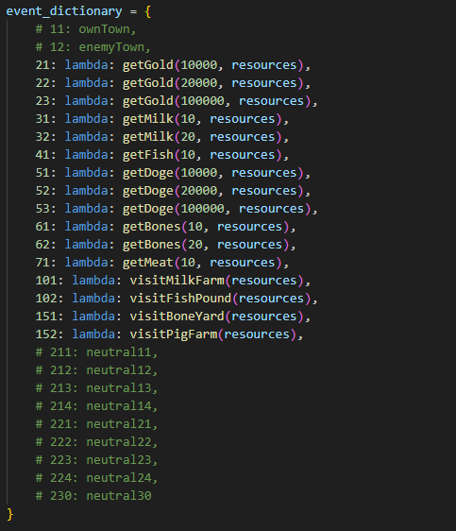
Event map dictionaries

Slide 16
Challenges
Time management and prioritizing.
Artwork and tilesets.
Refactoring/optimizing after the last code review.
Starting from zero.
Battle system.
Game lagging – resolved by editing the assets.

Slide 17
Future development
Battle system implementation.
Marking the ownership of the farms.
AI implementation for Shaq
Moving mechanics need improvement.
Moving from QUAD to HEX tiles.
Drawing own artwork and tilesets.
Using professional tools for map creation.
Full screen mode
The project can easily expand by adding maps, units, towns, fractions, campaign mode etc.
Moving to different dev environment.

Slide 18

Thank you
For your attention
https://github.com/hristogwivanov/PetWars
No animals were harmed in the making of this game!

